Slide 1
CHITETEZO IoT-BASED AIR POLLUTION MONITORING SYSTEM - using Raspberry Pi 3

Slide 2
GROUP 12 MEMBERS
Victoria Kamuona Bsc-com-ne-13-18
Maxon Gomeka Bsc-com-ne-12-18
Evelyn Phalula Bsc-com-ne-03-18
Tsanzo Makuya Bsc-com-ne-09-18

Slide 3
PROBLEM STATEMENT
Air pollution is a global issue and many countries including Malawi are facing this problem, especially in urban areas.
Air pollution is a result of harmful gases which are released into the air from homes, industrial areas, and other places that use appliances or systems that produce gas.
Presence of harmful gases in the air can pose a huge health risk and impact people well being.
It is necessary to monitor these harmful gases and find solutions based on data that has been collected electronically.

Slide 4
OBJECTIVE
Our main objective is to monitor and record the level of concentration of harmful gases in order to define the air quality levels and inform the authorities to establish action plans if high levels of contamination are detected.
Pollutants are, for example:
Carbon monoxide (CO)
Carbon dioxide (CO₂)
Particulate matter
Ozone
Volatile organic compounds (VOC)
Smoke
Alcohol
Nitrogen dioxide (NO₂)
Notes:
Authorities from where our system will be implemented.

Slide 5
FUNCTIONAL REQUIREMENTS
Real-Time data collection, Data transmission, Data analysis and visualization, Data exporting, Data storage, and retrieval – The system will be able to collect real-time data on the aggregate pollutants and also process and analyze the collected data to generate meaningful insights such as pollutant concentration, etc.
Alerts and Notifications - The system will provide timely alerts and notifications when pollutants exceed a predefined threshold.
Multi-interface data display
Notes:
Data transmission – The system will have reliable communication capabilities such as Wi-Fi and cellular connectivity to transmit the collected data to Chitetezo Dashboard, Thingspeak, and Chitetezo Mobile App.
Data analysis and visualization - The system will be able to analyze the data collected from the sensors and provide visual representations of air quality measurements, such as graphs, charts, or maps.
Data exporting – The system will export air quality information in various formats such as CSV files for further analysis.
Data storage and retrieval -The system will store a sample of the data collected in a database which can be used for future analysis or to generate reports.
Low power consumption - The system will be designed to consume low power to reduce the cost of operation and minimize the environmental impact.

Slide 6
NON-FUNCTIONAL REQUIREMENTS
Reliability
Accuracy
Scalability
Security
Timeliness
Notes:
Reliability: The system should be reliable, with a high degree of uptime and minimal downtime. It should be designed in a way that minimizes the risk of failure or errors.
Accuracy: The system should provide accurate readings of air quality parameters to ensure that the data collected is reliable and can be used for further analysis.
Scalability: The system should be scalable, with the ability to handle increasing volumes of data and additional sensors as the need arises.
Security: The system should be secure, with measures in place to prevent unauthorized access or data breaches. This could include measures such as encryption, authentication, and access controls.
Timeliness :The system must be able to capture and report air quality data in real-time, as air quality conditions can change quickly and affect human health and the environment.

Slide 7
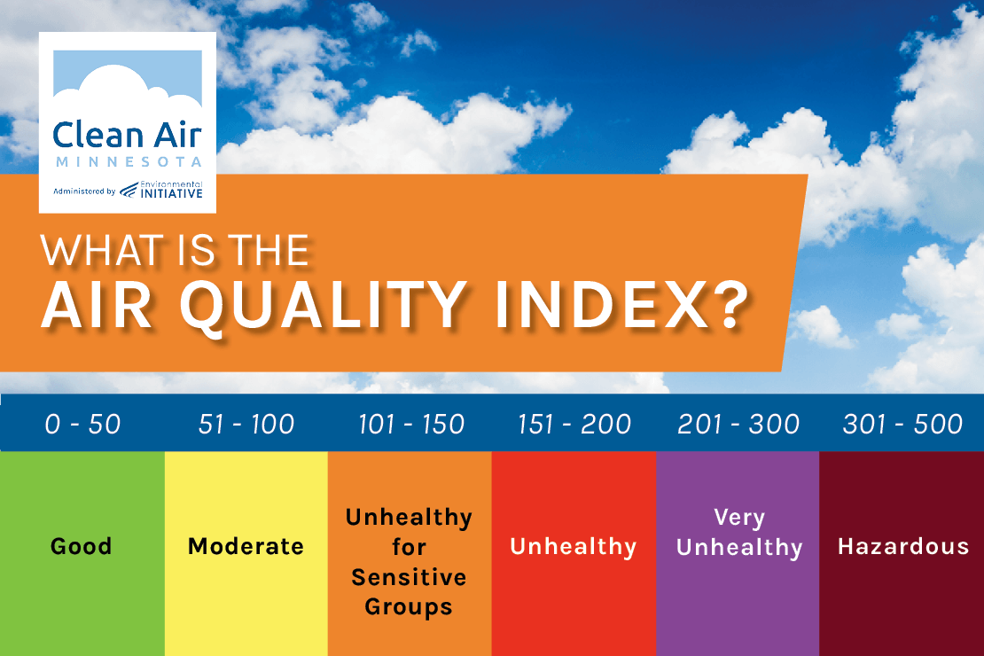
bhhuyyuyyyhjklknkjjnjknj
HOW IS THE LEVEL OF AIR QUALITY MEASURED?
The Air Quality Index (AQI) is used to measure air quality. It tells you how clean or polluted your air is, and what associated health effects might be a concern for you.
Uses the range of 0 to 500 to indicate the concentration of pollutants in the air at a specific site. An AQI at or below 100 is generally considered safe for most people. Anything above 100 is unhealthy for sensitive groups.
Parts per million (PPM) is a unit of measurement used when expressing the concentration level of pollutants in the air.
There are six color-coded levels of concern corresponding to ranges of index values as shown below

Slide 8
PROPOSED SOLUTION OF MONITORING AIR POLLUTION
Our purpose is to develop and design a system that will monitor and record the concentration of harmful gases in particular environments.
The system will monitor the level of harmful gases using gas sensors. This sensor will collect real-time data and send it to Raspberry Pi. From the Raspberry Pi, the captured information will be stored in a database and also sent to the Chitetezo dashboard, Chitetezo mobile app, and ThingsSpeak (Cloud IoT platform).

Slide 9
MATERIALS
Hardware specifications
Raspberry Pi-3
Gas sensor; MQ-135
16*2 LCD
Buzzer
LED warning lights
ADC converter
GSM Module
Potentiometer
Software specifications
Programming languages; python, C, JavaScript, and Dart
Notes:
Raspberry Pi uses python
We are using Arduino as a converter; Arduino uses C
JavaScript for socket programming
Dart for developing our mobile app

Slide 10
A BLOCK DIAGRAM OF THE CHITETEZO AIR POLLUTION MONITORING SYSTEM
Power Supply
ThingSpeak
GMQ2
Gas sensor
ADS1115 ADC
Raspberry PI 3
Chitetezo Dashboard
MQ135
Gas sensor
Chitetezo mobile app
DHT22
Humidity sensor
LCD
LED
Buzzer
Notes:
HOW IT WORKS
Our system monitors the level of air quality of the harmful gases by using gas sensors to collect real-time
indoor air quality data and send it to an ADC converter and then to Raspberry Pi. The SI unit of data is parts per million (ppm).
The Raspberry Pi sends the real-time to our mobile app, website(dashboard), and also Thingspeaks (IoT platform).
The real-time data is also being stored in our database in the Raspberry Pi for future use.
The dashboard displays the real-time data on a line graph and also some of the widgets including the gauge, indicator, and decimal.
These sensors measure the level of air quality of harmful gases in the atmosphere.

Slide 11
DEMO

